Slide 1

Project Black Sky: Watching the Watchers
Suspicious skies, revealed.

Slide 2
Methodology
Data engineering
Fetched and cleaned TLE/GP history for 180 days
Deduplicated by NORAD ID and latest epoch
Merged with UCS metadata
Feature Engineering
Physics-informed features from harmonized TLE/GP data
Special focus on RAAN drift vs. J2 perturbation model
Anomaly Detection
Isolation Forest

Slide 3
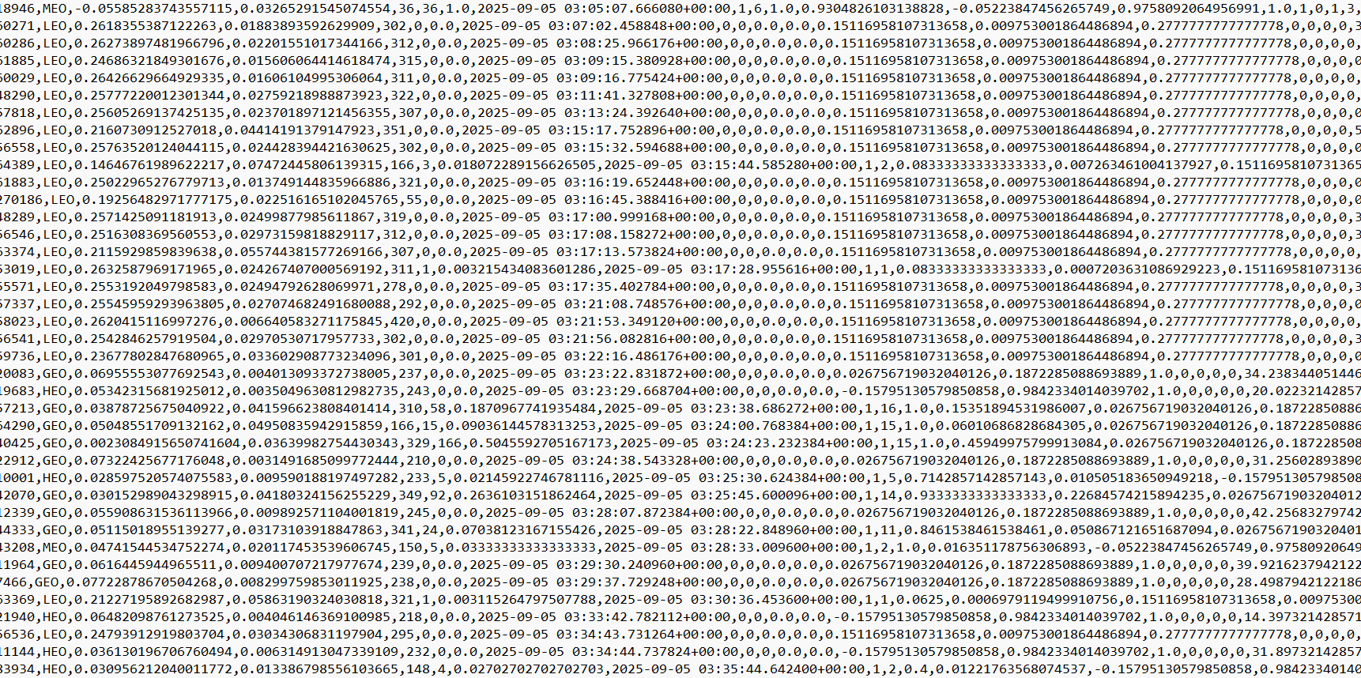
anomalous_rows.csv
scores.csv
dailies.csv

Slide 4
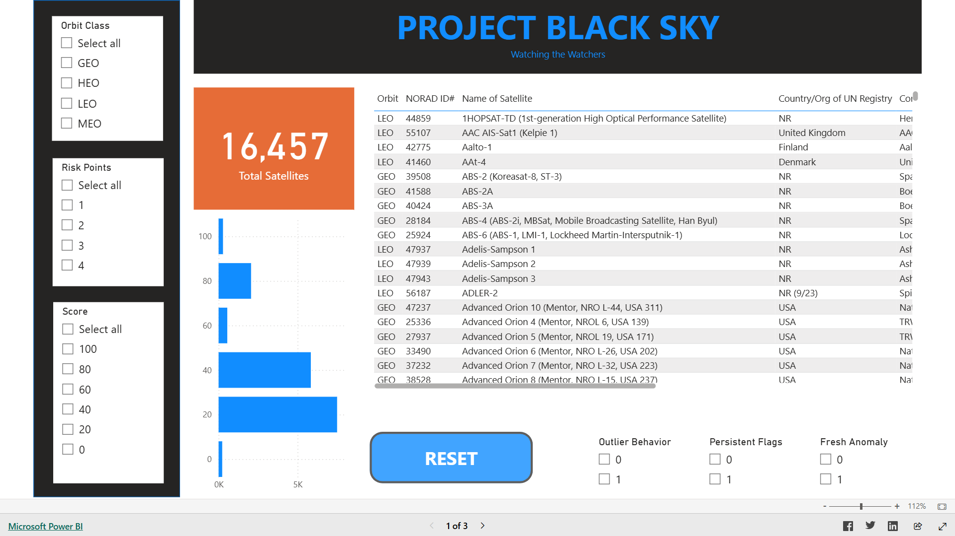

Slide 5
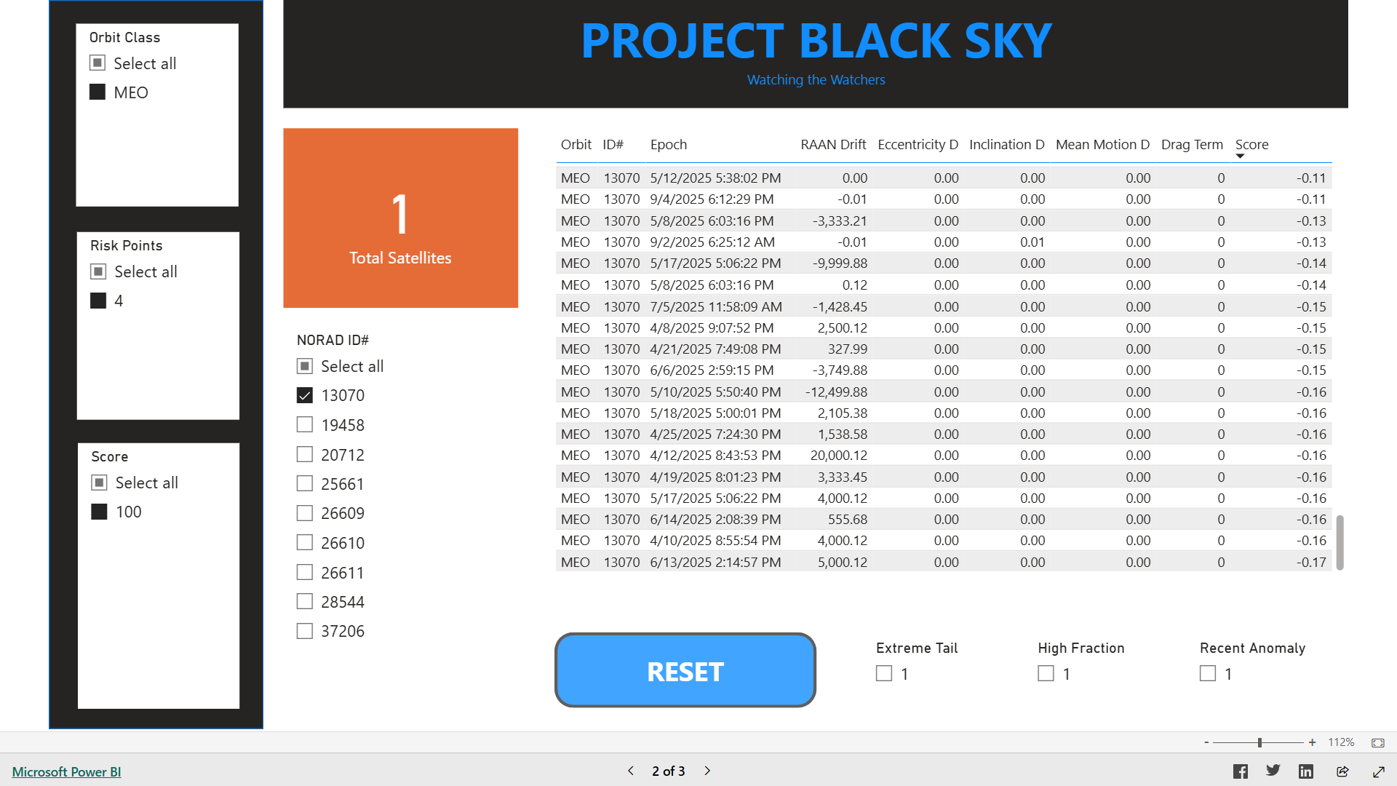

Slide 6
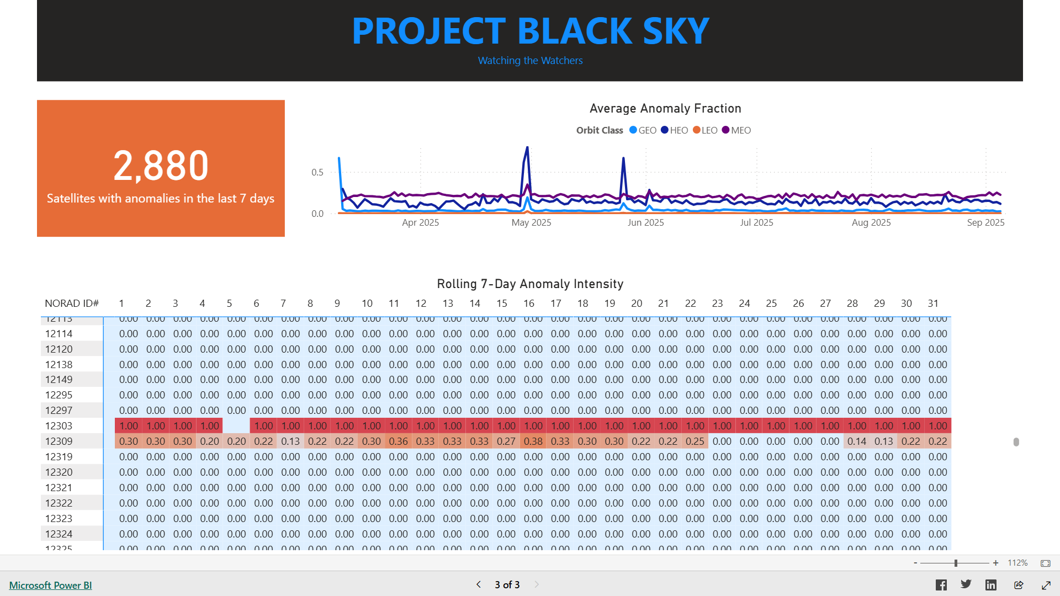

Slide 7
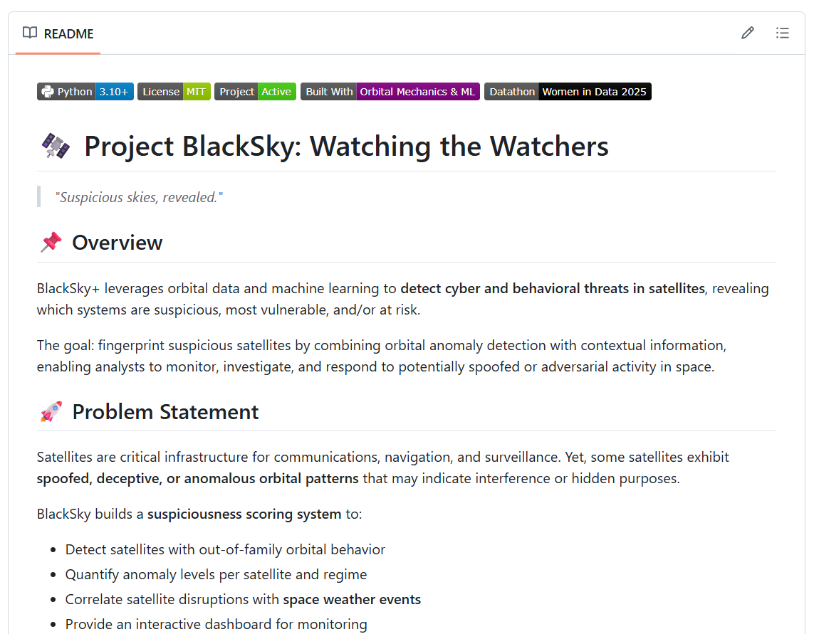

Slide 8

A datathon project by:
Elaine’s Datanauts
Team Members:
Ednalyn C. De Dios
Marwah Obaid
Peace Edwins
Saarah Hossain
Tuhina Chaudhari

